Slide 1
League of Legends-
Analysis and Prediction
第12組
106306032 資管四 楊存濬
106306069 資管四 汪君儫
106306076 資管四 謝采辰
108304056 統計二 陳岷逸

Slide 2
Goal
What are the important factors in a match to win?
What champions should I choose for a higher winning rate?
How is the relation of KDA (Kill, Death, Assist) between different roles in a match?
Use the dataset to train model in order to predict the match outcome.

Slide 3
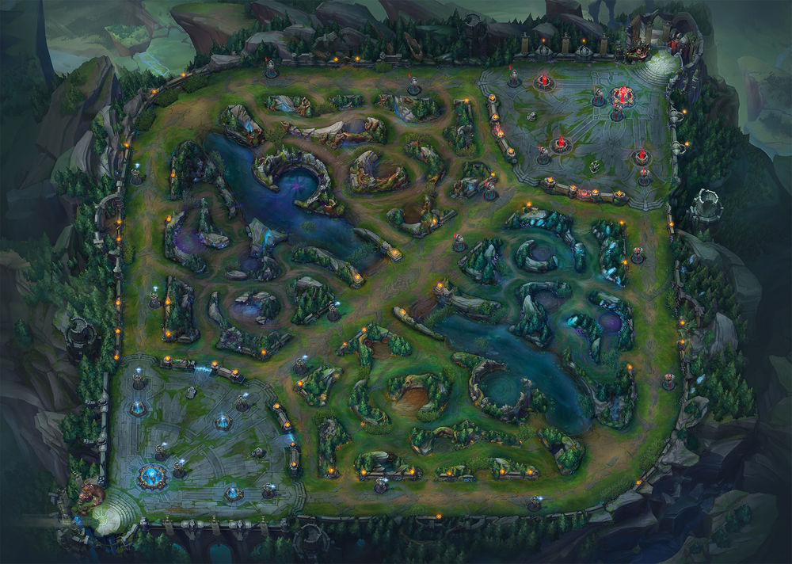
League of Legends summary
Top
Purple
Barron/
RiftHerald
Mid
Jungle
ADC
Dragon
Blue
Sup

Slide 4
Data
Take data integrity and consistency into account, we believe that professional players will have more stable performance in games. So we select active professional players in North America teams as targets of analysis, and crawl data of recent 100 matches of each player via “Riot developer API”.
In one match data , there are many details, including:
firstBaron: [boolean] Flag indicating whether or not the team scored the first Baron kill.
firstInhibitor: [boolean] Flag indicating whether or not the team destroyed the first inhibitor.
firstTower: [boolean] Flag indicating whether or not the team destroyed the first tower.
team:{‘blue’,’ purple’}, role:{‘top’, ‘jungle’, ‘mid’, ‘ad’, ‘support’}
team_role_kda: [numeric] calculate by (team_role_kill + team_role_assists) / team_role_death
team_role_champname: [integer] champion id

Slide 5
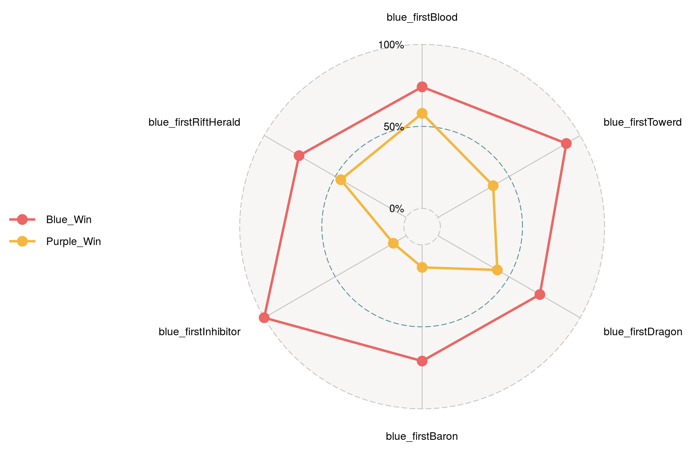
Data
In Match, we found that first inhibitor, first baron and first tower had more significant results on the results of the game, and first dragon, first rift herald and first blood had less impact on the results.

Slide 6
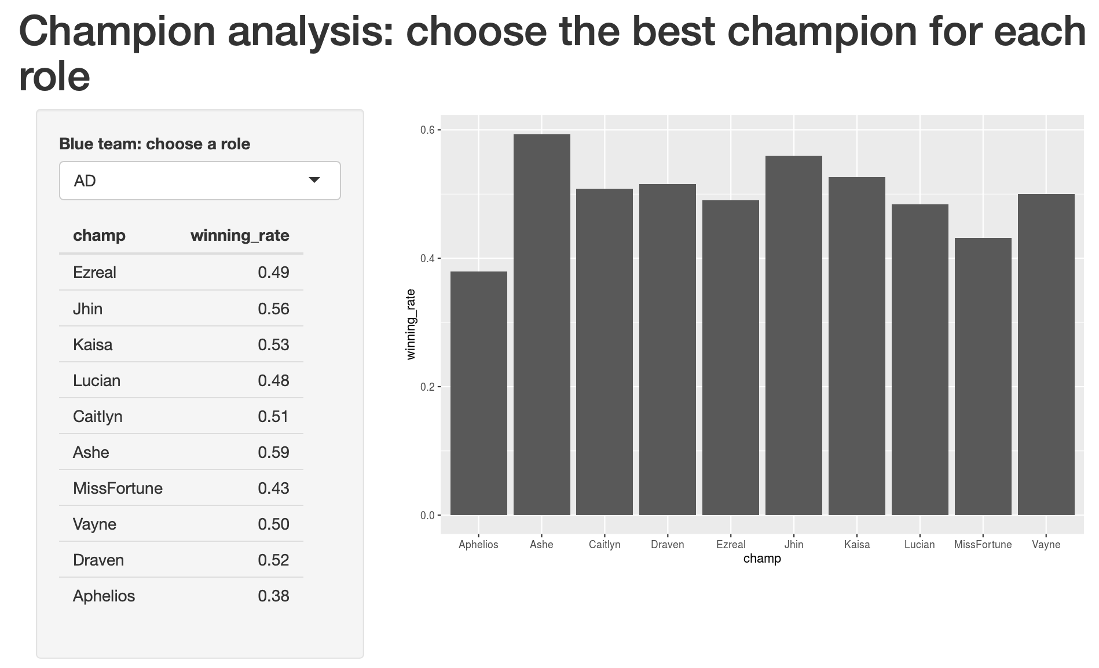
Data
I
In Champion, we provide the winning rate of the top 10 champion in each position of blue and purple.

Slide 7
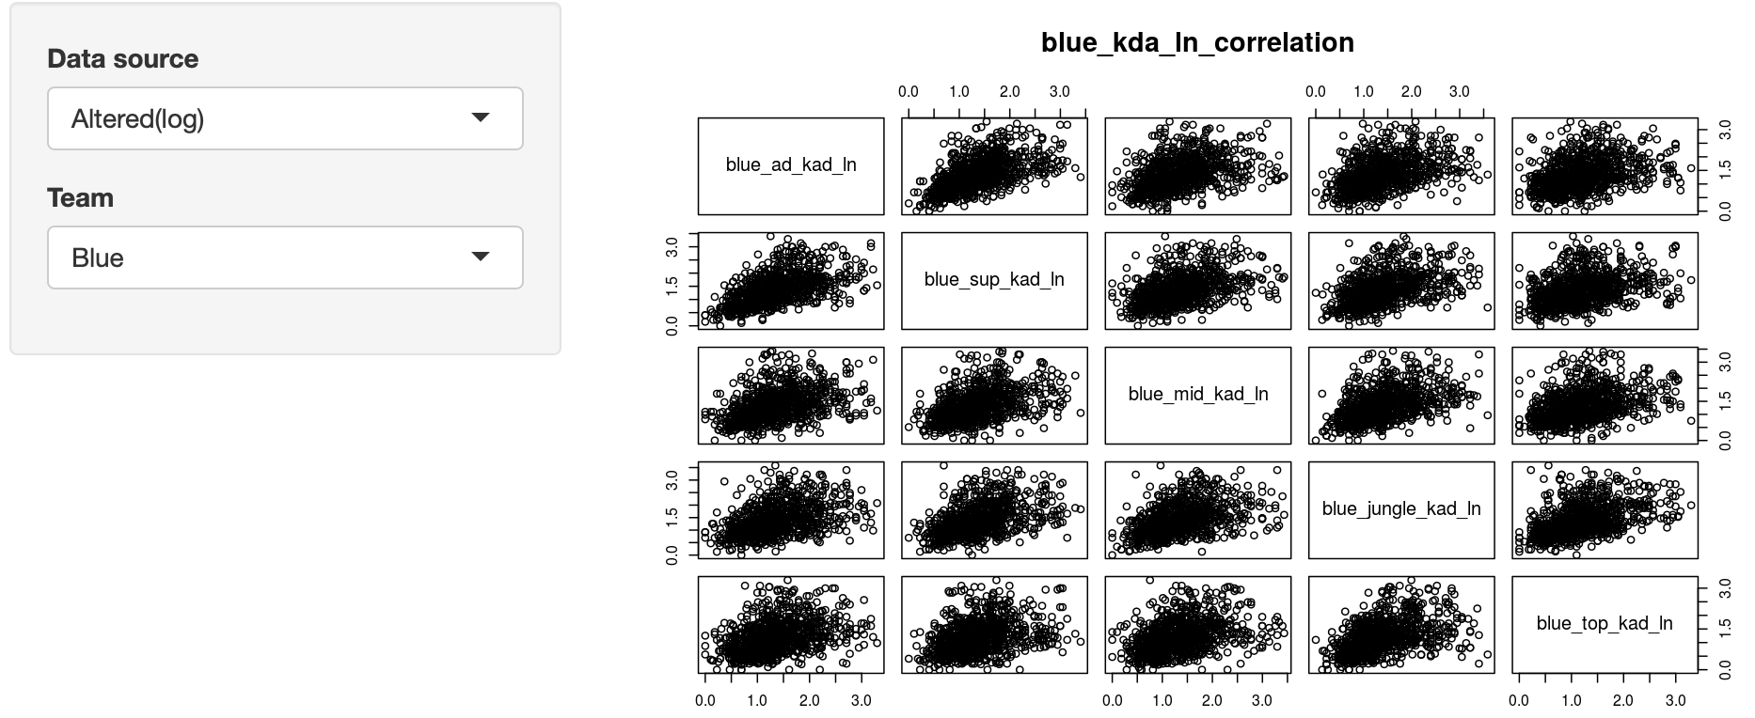
Data
In KDA, we observed the player's KDA (kill+assist) / (death).
We found that the KDA data has the characteristics of left-biased peaks, so the data +1 is taken as a new feature that can be considered.

Slide 8
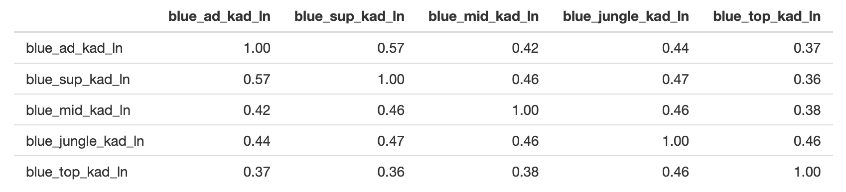
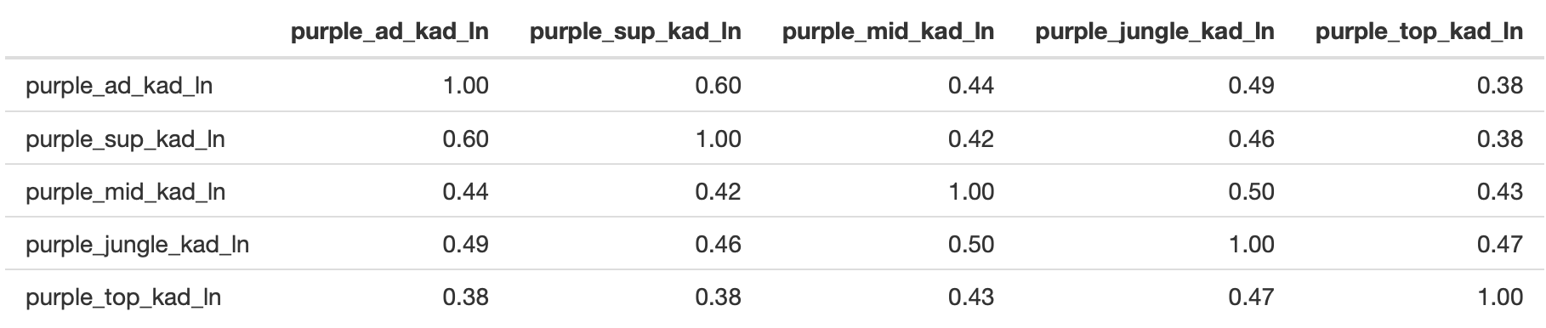
Data
From the data, we can see that the correlation between support and ADC is high, while the correlation between top and other teammates KDA is low. However, there is no obvious correlation between each other.

Slide 9
Method
Decision Tree: control=rpart.control(maxdepth=j, minsplit=2), method = 'class' (j = the best maxdepth chosen through loop)
Naive Bayes
Support Vector Machine:
(cost in 10^(-1:2), gamma in 0.5:2)
Random Forest:
control=randomForst.control(ntree=ntree, maxnode=maxnode))
(ntree in 1:5, maxnode in 1:5)

Slide 10
Evaluation
Cross-validation
Accuracy
Area Under Curve (AUC)
Null model: assume blue team wins each match

Slide 11
Result
Reactive Visual Graphs via Shiny:
https://tsai00150.shinyapps.io/League-of-Legend-Analysis-and-Prediction/
Challenging part:
Our data mainly uses the data from the professional players, so the condition and mindset might be different from casual players
Might require more features to make even more precise predictions in the future.
The limitation of data being able to acquire due to League of Legends official website.

Slide 12
References
Documentation:
https://shiny.rstudio.com/tutorial/ https://developer.riotgames.com/ https://www.rdocumentation.org/packages/rpart/versions/4.1-15/topics/rpart https://www.rdocumentation.org/packages/e1071/versions/1.7-3/topics/naiveBayes https://www.rdocumentation.org/packages/randomForest/versions/4.6-14/topics/randomForest https://www.rdocumentation.org/packages/e1071/versions/1.7-4/topics/svm
Packages: xlsx、ggplot2、ggradar、scales、dplyr、tibble、openxlsx、shiny、pROC

